Slide 1
Design and Installation of a Video Conferencing Solution at the Center of Excellence in Remote Sensing Education and Research at Elizabeth City State University
Networking Team
Video Conferencing
Students:
Jefferson Ridgeway
Kevin Benton
Daquan Rascoe
Mentor:
Mr. Carlton Lamb

Slide 2
Abstract
During the 2016 Spring Semester, the Research Experience Undergraduates Networking team project identified, evaluated, and implemented a video conference solution. The main objective was to establish a fully functioning video conferencing solution in four locations: Dixon-Patterson Hall, Rooms 226, 232 and Lane Hall, Rooms 111 and 119. To understand and create the scope of the work for the project, the team had to research/analyze the rigorous standards which are set in place by the International Telecommunications Union. This agency works directly under the authority of the United Nations and is charged with issues relating to information and communication technologies. The team examined the H.323 standard for Telemedicine, how Telemedicine has evolved, and how the H.323 standard has progressively changed the way we conduct our lives. After replicating the layout of the four spaces, the next objective was to identify and evaluate a software solution. After identifying and evaluating multiple video conferencing applications, the team selected a specific application. An example of an issue which eliminated one application was when an application indicated that a user would only have to open a link in the browser to be able to connect; but it did not indicate that the link would only work from within a certain browser. As for the hardware, the technical specifications of components were used to identify the hardware components. This method of selection, immediately gave preference to specific devices. The team also analyzed the history of video conferencing and how it has evolved. This research project enables the Center of Excellence in Remote Sensing Education and Research (CERSER) participants and invited guests to engage with others through video conferencing services.
Keywords – Networking, video conferencing, CERSER, ECSU

Slide 3
What is Video Conferencing?
Video conferencing is a method of communication that incorporates both picture and audio simultaneously.
It has standards that are managed by several organizations like the International Telecommunication Union (ITU) and the International Organization for Standardization (ISO)
The New Gold Standard for Video Compression is H.264 Standard

Slide 4
History
Video conferencing goes as far back as the invention of television
Introduction of Teleconferencing
Major event in 1927
Elements of video conferencing
Notes:
by Herbert Hoover in 1927, which is also the year that the first video conferencing tool called television was invented [1]
are used as communication tools daily by people everywhere whether if it's for companies, organizations, or just your average person wanting to communicate through video conferencing.
between Washington DC and New York as Herbert Hoover’s image was sent by cables simultaneously as his voice was transmitted through phone lines [1]

Slide 5
Understanding the need- Creating the expectation!
Current ability to perform videoconferencing
What are the options now
Locations - Dixon-Patterson Building, and Lane Hall
Benefits of videoconferencing
Training Sessions
Meetings
Content Sharing
The issues last semester
Poor video
Poor audio
Notes:
On this slide the font size of “Benefits of videoconferencing” is different from the other lines of text.

Slide 6
Our Hardware
Logitech Conferencecam BCC950 Video Conferencing camera
Logitech Conferencecam CC3000e USB 2.0 Video Conferencing Camera
The Logitech cc3000e is a system that has, “H.264 with Scalable Video Coding (SVC)”, “convenient Bluetooth technology and Near Field Communication (NFC)”, and is said to be likely compatible with any software that is used regularly [2].
New MacBook Air laptops with a combination of wired and wireless connection to the internet.

Slide 7
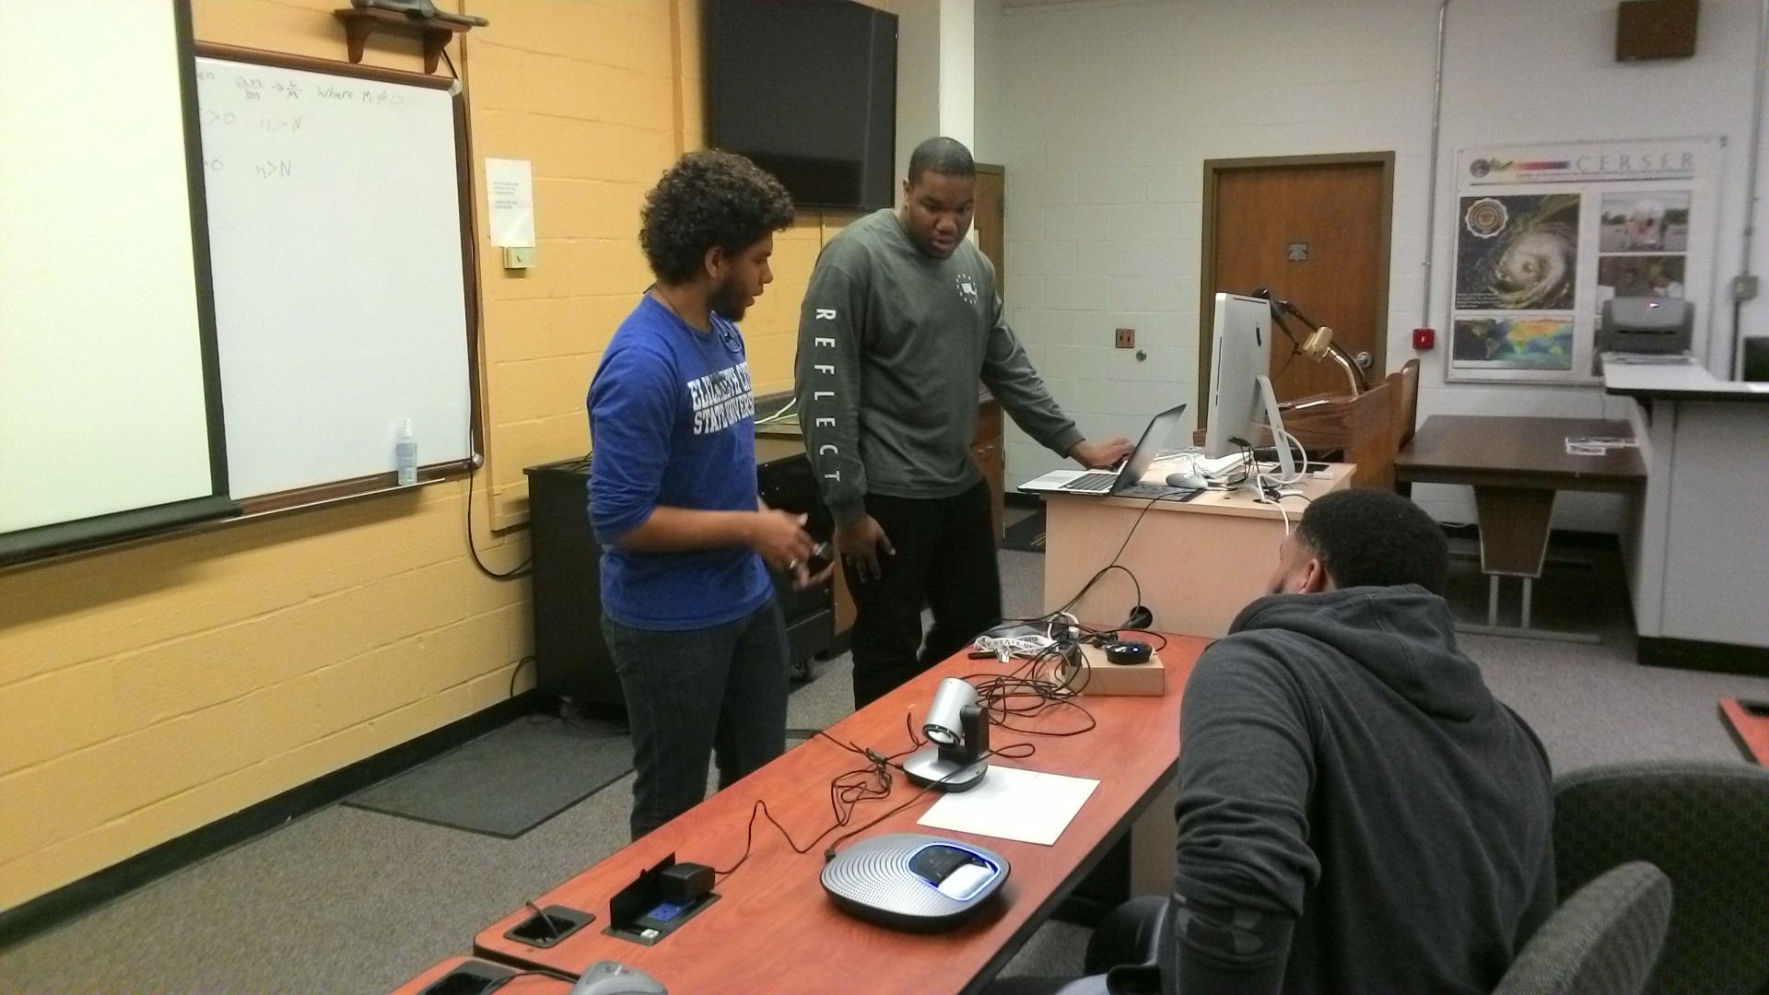
The Logitech cc3000e system with the team

Slide 8
Research
A list was comprised of ten different solutions and from this pool of software collected, the team picked the most current, efficient, and inexpensive solutions from that list.
Narrowed the list further by using a set of criteria
This criteria used: Is the solution inexpensive (or can be paid at one time without subscription service)? Is the solution compatible with different computers, laptops, smartphones, hardware, etc.? Is the solution user-friendly and efficient to use?
Thus from those ten programs the team came up with three programs: Join.me, Skype, and Google Hangout

Slide 9
The Result
After collecting and testing the three softwares using a selective rating system, Google Hangout, Skype, and Join.Me, the team then had to conduct the analysis of the findings from the rating system.
The ratings of each team member were compiled and then averaged in an excel spreadsheet.
Figure 1 shows what was gathered
Figure 2 shows the Network Speed at different points of the day.
Notes:
Is the solution inexpensive (or can be paid at one time without subscription service)? Is the solution compatible with different computers, laptops, smartphones, hardware, etc.? Is the solution user-friendly and efficient to use?

Slide 10
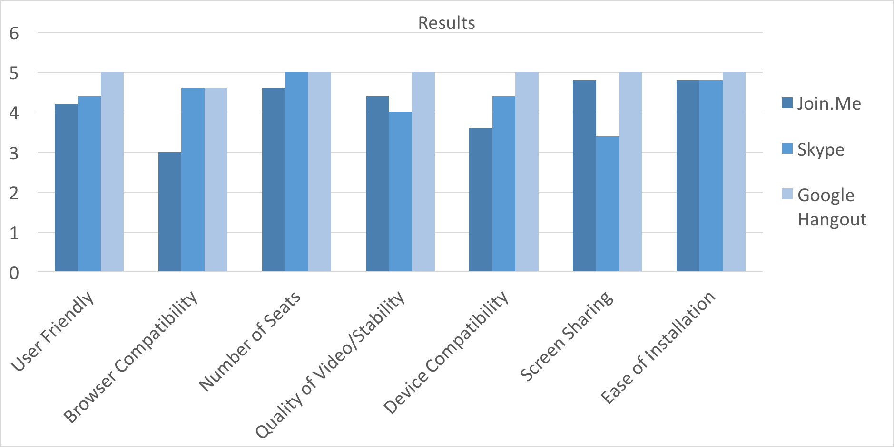
Figure 1

Slide 11
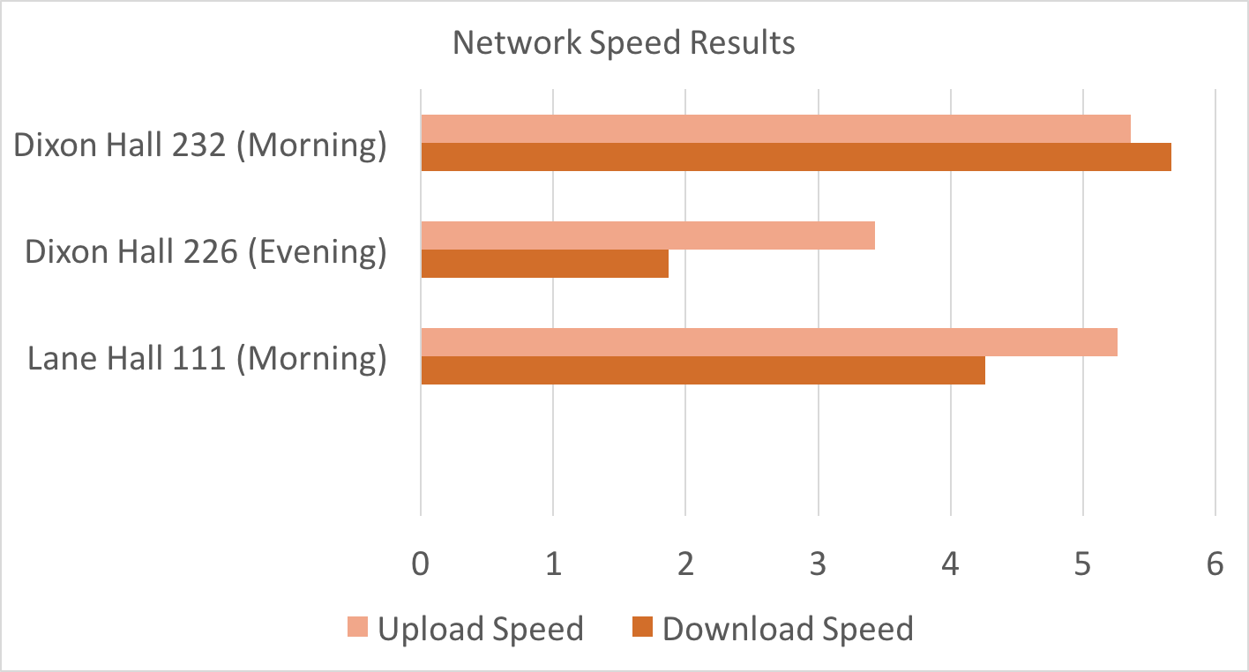
Figure 2

Slide 12
Conclusion
Based on the results from the findings and averaging the numbers from the rating system, Google hangout was rated the best among all of the criterion
The best time to do a video conference in either Lane Hall or Dixon Hall would be to do the conference in early morning to the mid-afternoon. Facilitating a video conference during this time period would be the best time.

Slide 13
Future Work
In continuing this project, the hope is to enhance the environment in which video conferencing take place.
Add better lighting in both Lane Hall and Dixon Hall and adding the signage of the university in the background of each video conference location.
Furthermore, the research would also obtain better audio so that attendees can hear each other clearly and concisely.
In the future, the research would continue to test Google Hangout on both wired and/or wireless connections to optimize the performance and experience for the user.
Understanding that the team researched free options for video conferencing software,. In the future, the research would potentially incorporate a fully paid version that would have a higher refresh rate which would mean a better quality of video compression so that the attendees would see each other clearly.

Slide 14
References
M. Pourazad, C. Doutre, M. Azimi and P. Nasiopoulos, "HEVC: The New Gold Standard for Video Compression", IEEE Consumer Electronics Magazine, pp. 36-46, 2012.
[2]"Logitech CC3000e Video Conferencing System for 6-10 people", Logitech.com, 2016. [Online]. Available: http://www.logitech.com/en-us/product/conferencecam-cc3000e. [Accessed: 29- Mar- 2016].
[3]"Google Hangouts", Hangouts.google.com, 2016. [Online]. Available: https://hangouts.google.com/. [Accessed: 29- Mar- 2016].
[4]"Skype | Free calls to friends and family", Skype.com, 2016. [Online]. Available: http://www.skype.com/en/. [Accessed: 29- Mar- 2016].
[5]"join.me“ Free Screen Sharing, Online Meetings & Web Conferencing", join.me, 2016. [Online]. Available: https://www.join.me/. [Accessed: 29- Mar- 2016].

Slide 15
Acknowledgement
We would like to acknowledge the leadership of Dr. Linda Hayden who has provided the funding and the opportunity for this project's completion.
Notes:
I I recommend changing the word “assistance” to “leadership” or “direction”

Slide 16
Questions?

